Slide 1

Awesome Chocolate Sales
Clivert Beckett Ayisi-Ansah

Slide 2
Objective
Benefits
Key Questions
Assess the overall sales performance of chocolates across different countries.
Identify top-performing and underperforming regions and products.
Calculate key metrics: total sales, boxes, shipments, cost, and profit.
Leads to improved decision-making for the business.
Increased Profitability
Enhanced Customer Satisfaction
Competitive advantage
Which countries are driving the most sales and profit?
Are there any countries underperforming? And who are the salespersons responsible?
Which products are most popular in each country?
Notes:
Objective
- Analyse the overall sales performance of chocolates across different countries to identify top-performing and underperforming regions and products.
- This objective will involve calculating key metrics such as total sales, boxes, shipments, cost, and profit for each country.
Problem Statements
Uneven Regional Performance:
Why: This issue indicates that the current strategies may not be universally effective, requiring region-specific adjustments.
Action: Conduct a deeper dive into each region's unique characteristics (e.g., consumer preferences, competitive landscape, economic factors) to tailor strategies accordingly.
Salesforce Ineffectiveness:
Why: A poorly performing salesforce can significantly impact revenue and profitability.
Action: Implement a comprehensive sales training program, provide better tools and resources, and consider performance-based incentives to motivate salespeople.

Slide 3

Awesome Chocolates Dashboard

Slide 4
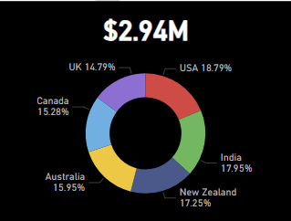
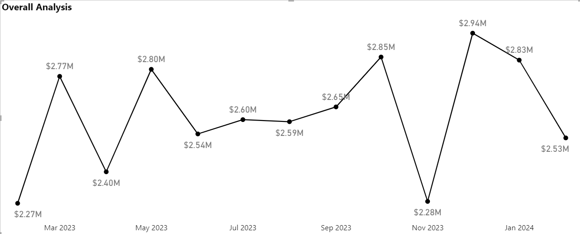
Total Sales from February 2023 to February 2024
The highest revenue was in December 2023 at 2.94M, followed by October 2023 at 2.85M, and January 2024 at 2.83M.
5.04M
7.74M
7.84M
8.07M
5.36M
March
June
September
December
Q1
Q2
Q3
Q4
Q1
2023
2024

Slide 5
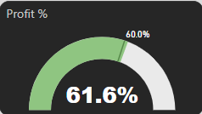
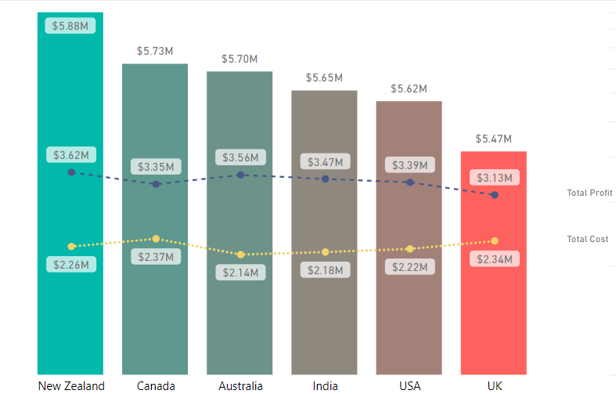
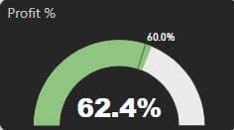

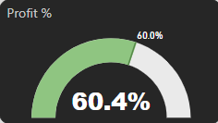
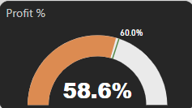
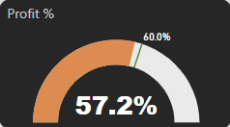
Total Sales, Profit, and Cost in Each Country
New Zealand has the highest sales, Australia has the highest profit percentage, and the UK and Canada are the unperforming countries.
New Zealand
Australia
India
USA
Canada
UK

Slide 6
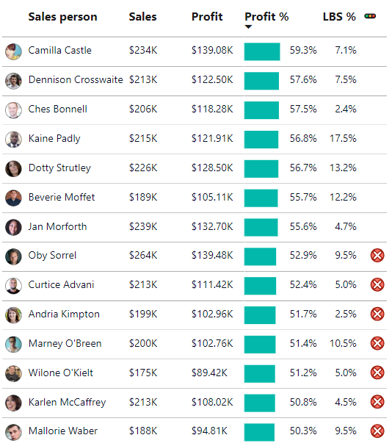
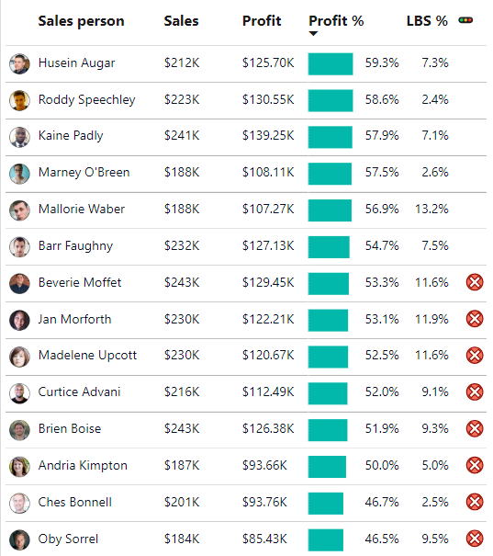

Underperforming Sale Representatives in Canada and UK
The UK has 16 underperforming sale representatives with 9 reaching well below the target, and Canada has 15 underperforming sales representatives with also 9 well below the target.
UK
Canada

Slide 7
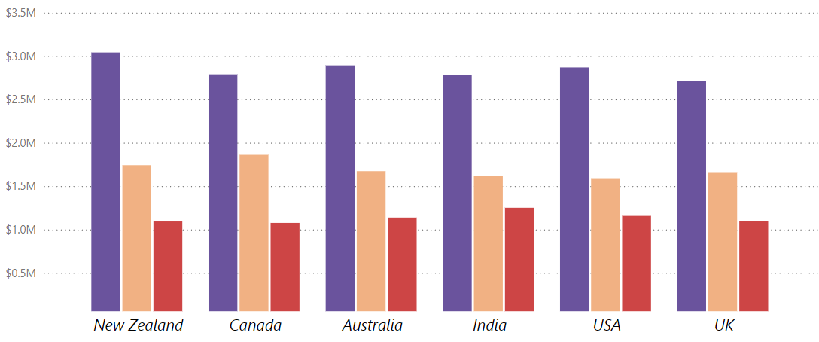

Chocolate Sales: Country-by-Country Breakdown
Chocolate bars are the most popular, followed by chocolate bites, then other chocolates.
Notes:
Other chocolates – chocolate cake

Slide 8
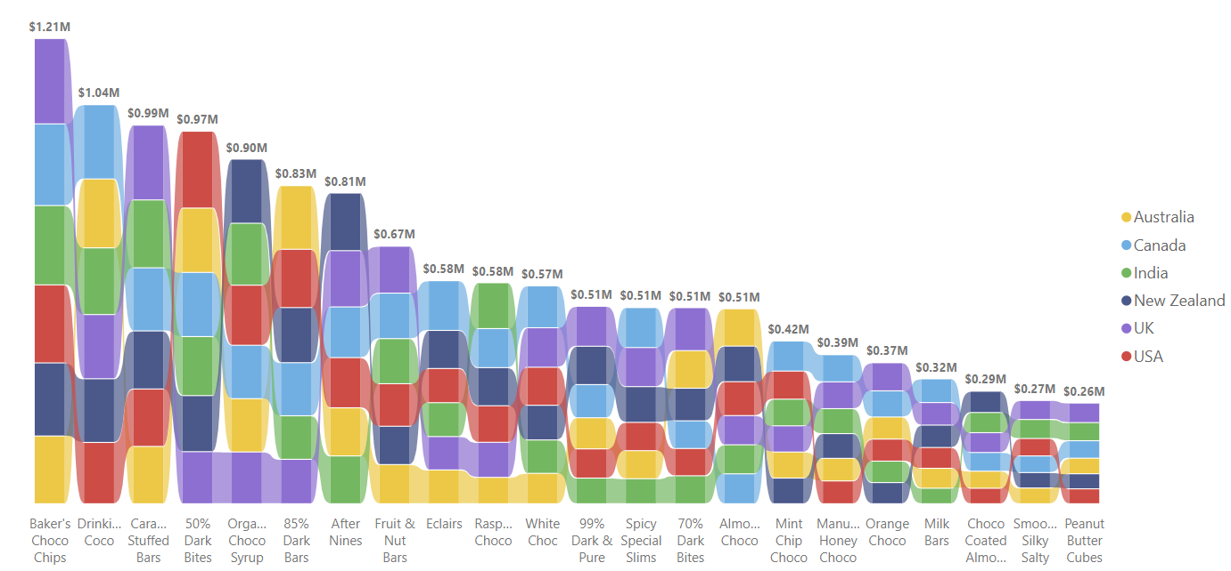
Global Market Analysis: Chocolate Product Performance
Barker’s Choco Chips generated the most sales at $1,200,000 and peanut butter cubes chocolate generated the least sales at $260,000.

Slide 9
Conclusion
New Zealand and Australia emerged as top performers, generating $5.88M and $5.70M in sales, respectively, with impressive profit margins of 61.8% and 62.4%
The UK and Canada fell short of the 60% profit margin target. Despite Canada's high sales, its high costs hindered profitability. The UK, with the lowest sales and high costs, was also below target.
A closer look at the salesforce reveals that the UK and Canada are facing challenges with underperformance. In the UK and Canada, 16 and 15 representatives, respectively, are underperforming with both having 9 falling significantly below the target of 60% profit.
Chocolate bars are the most popular product across all regions. In the UK, Bakers Choco Chip is the top-selling chocolate bar, suggesting that targeting this product could drive significant sales and profit growth.

